Slide 1
Machine learning!
By me

Slide 2

What is it?
Subset of Artificial Intelligence
Form of data analysis that teaches a computer how to learn about data
Automates analytical model building
Goal of machine learning is to understand the structure of the data
Machine learning is a type of AI, they’re not mutually exclusive!

Slide 3
Life of an ML algorithm
Ask a question about data
Collect data
Train the algorithm on the data
Test algorithm on new data
Collect feedback
Use feedback in algorithm

Slide 4
Types of ML Algorithms
Supervised: Human provides labelled data for the algorithm to train on.
Ex. linear regression, random forest, SVM
Used in Siri/Cortana, Fingerprint ID, and email spam filters
Unsupervised: Algorithm only has access to unlabelled data
Ex. k-means clustering, singular value decomposition, nearest neighbor maps
Used in many neural networks
(Semisupervised)
Reinforcement Learning: Algorithm discovers through trial and error which actions yield the greatest rewards
Used in algorithms that play video games, robotics, and lots of other stuff

Slide 5

Supervised Machine Learning Problem Types
Regression: Predicting continuous valued output
Random Forest, Support Vector Regression
Ex. “Predict average house price based on average income in that area”
Classification: Predicting discrete valued output
Decision trees, Naive Bayes, K nearest neighbors, etc.
Binary classification: only 2 categories, usually labeled 0 and 1
Multi-class classification: more than 2 categories

Slide 6
Unsupervised Machine Learning Problem Types
Clustering: Discovering inherent groupings present in data
K-means, t-SNE, Spectral clustering
Ex. “What do customers tend to buy?”
Association: Discovering rules that explain associations between the variables
Apriori, FP-growth
Ex. “What do customers that buy product X also tend to buy?”

Slide 7
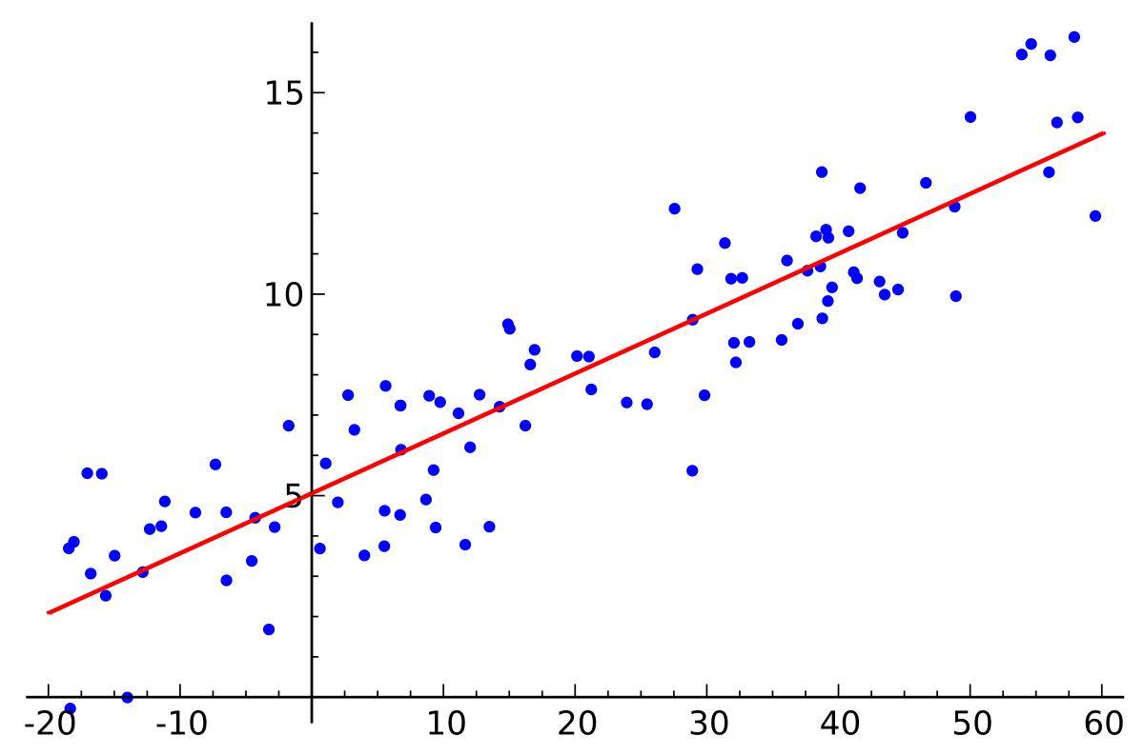
What is Linear Regression?
Simple way to predict output values given input data
One of the simplest algorithms for solving regression problems
Supervised machine learning algorithm
Assumes there’s a linear relation between the input value(s), X, and the output value(s), Y

Slide 8
How does it work?
The dependent variables are assumed to be linearly related to the independent variables
Thus we can write each dependent variable as a linear combination of the independent variables
𝒚 = 𝛃₀ + 𝛃₁𝒙 + 𝛃₂𝒙 + … + 𝛃_{𝑛}𝒙_{𝑛}
Each of the 𝛃_{𝑘} is a coefficient modifying the independent 𝒙_{𝑘} variable
Algorithm tries to minimize the error in the predictions vs. actual by changing the coefficient values

Slide 9
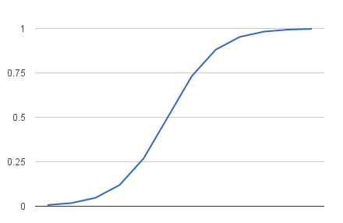
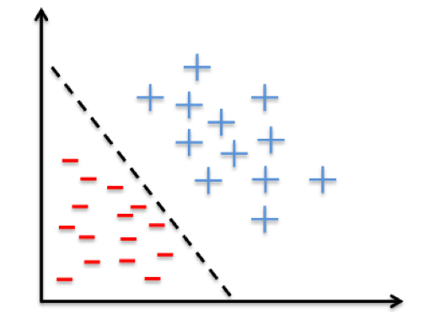
What is Logistic Regression?
Most basic method for binary classification problems
Supervised machine learning algorithm
Uses the logistic function, more commonly known as a sigmoid function
Models the probability an input belongs to the default class
Assumes all input belongs to one of two output classes
Easy to implement and efficient to train
Data must be linearly separable

Slide 10
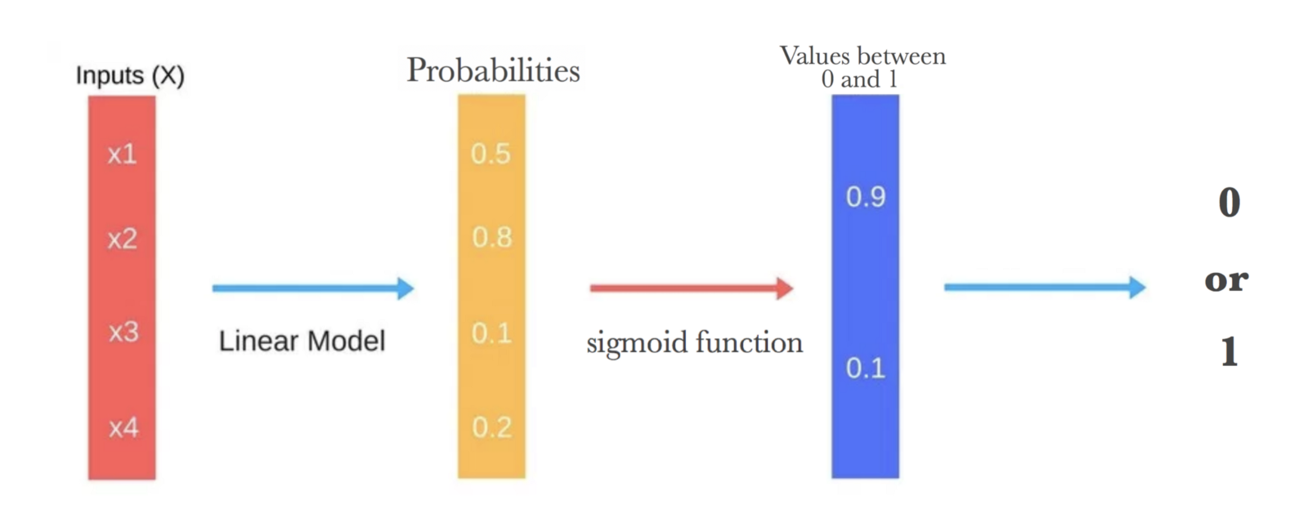
How do we do Logistic Regression?
We use Maximum Likelihood Estimation (MLE) to maximize the parameters of the sigmoid function
The math here is pretty hairy, but the computer does it quickly and accurately
If you’re interested, a good explanation is here
Use labeled data to train the model with MLE, then test with unlabeled data

